Slide 1
Cyclistic Case Study
How to Increase bike rental subscriptions

Slide 2
Strategic Goal
Increase Subscribers/Convert Casual Users to Subscription Model
Annual membership is proven to be more profitable than riders paying for daily/casual service

Slide 3
Analytical Focus
How are annual members using the service differently than casual users?

Slide 4
Cyclistic Pricing Model
Subscribers
Casual Riders
Annual Membership
Single-Ride Passes
Full-Day Passes

Slide 5
The Data
We initially looked at data sets from Q1 of 2019 and Q1 of 2020, seeing that the 2020 data doesn’t contain the gender or age of the rider like the 2019 set, we will be using the 2019 set only so take that into consideration
Data provided by Motivate International Inc.
This is public data but due to data-privacy restrictions, riders personal information is not included, meaning we will not know if one rider rents multiple times, which could possibly change the outcome of the results.
The data comes first-hand from a trusted source and appears public, proving its validity

Slide 6
Cleaning the Data
Hiding all unused columns
Calculating ride lengths for better understanding
Formatting changes to see specific days of the week
Formatting changes to time for readability
Removed any rides that exceeded a 24-hour span, these rides are known to be outliers based on users not ending their sessions properly via the app

Slide 7
Results

Slide 8
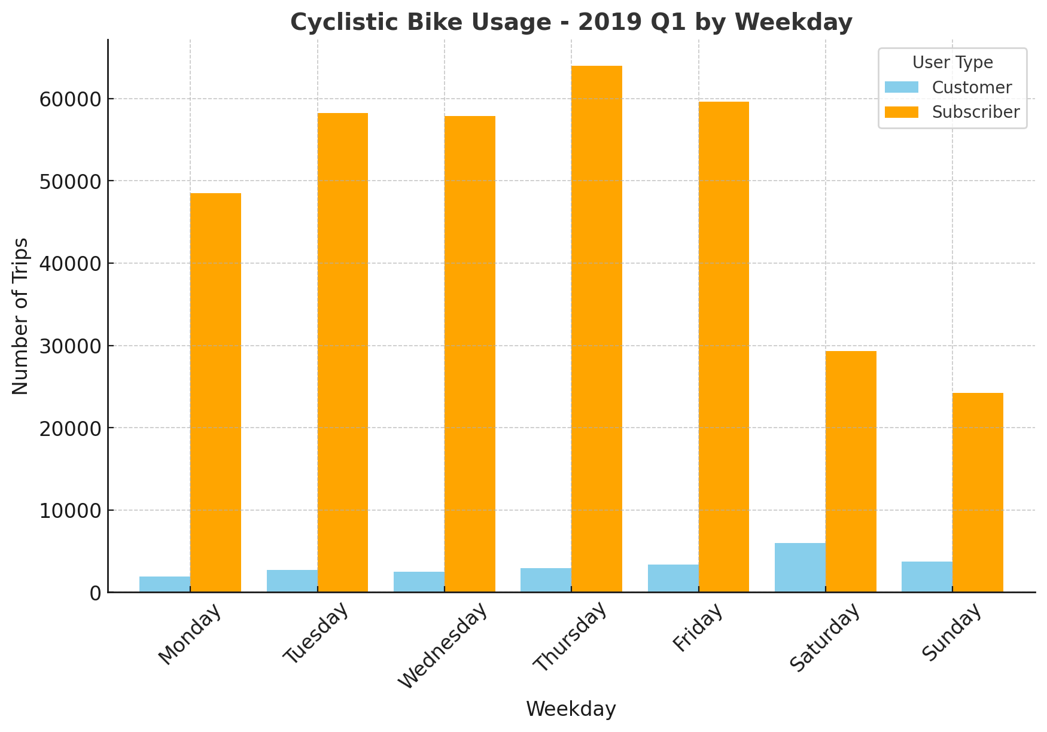

Slide 9
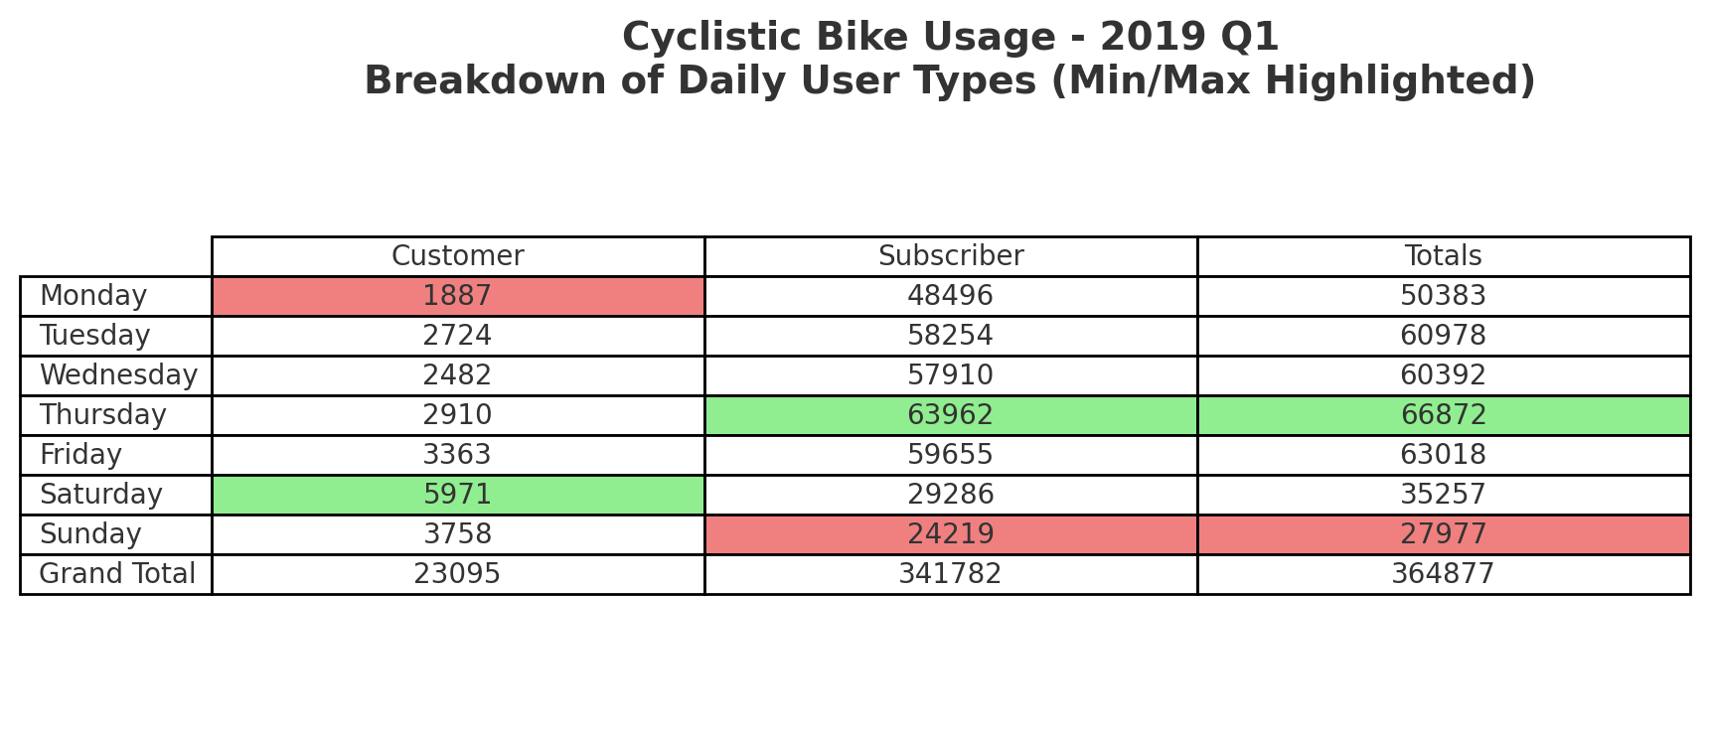

Slide 10
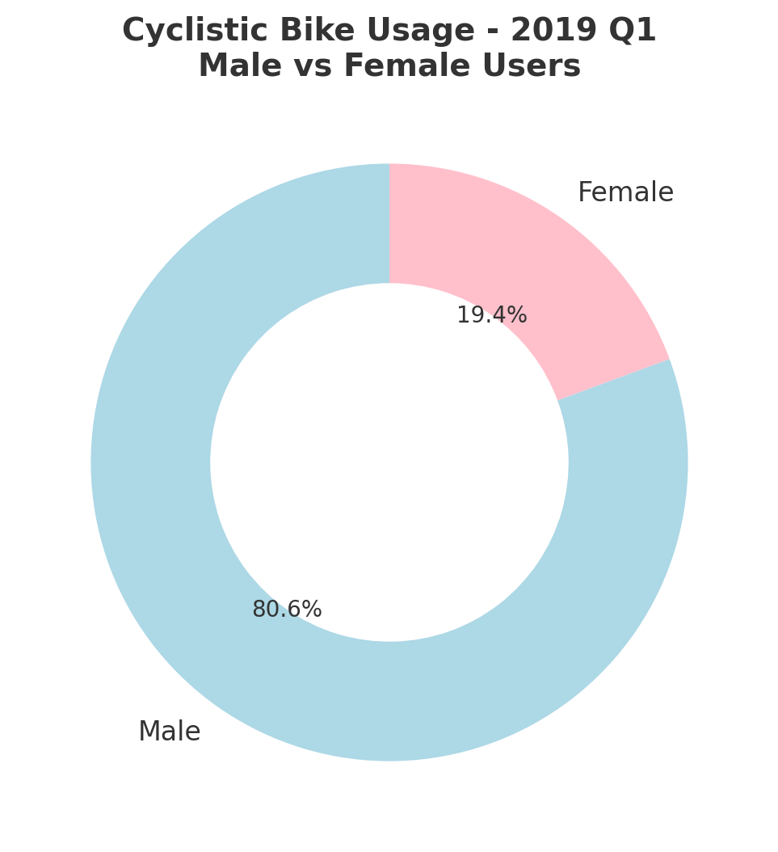
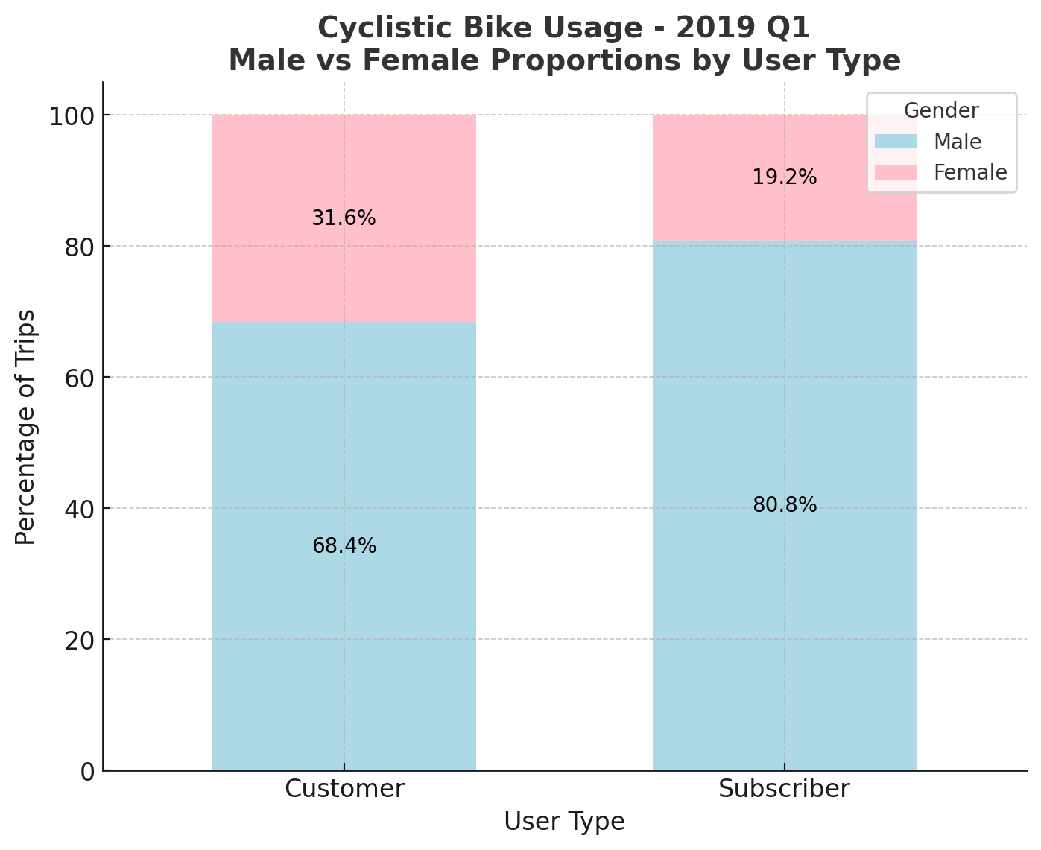

Slide 11
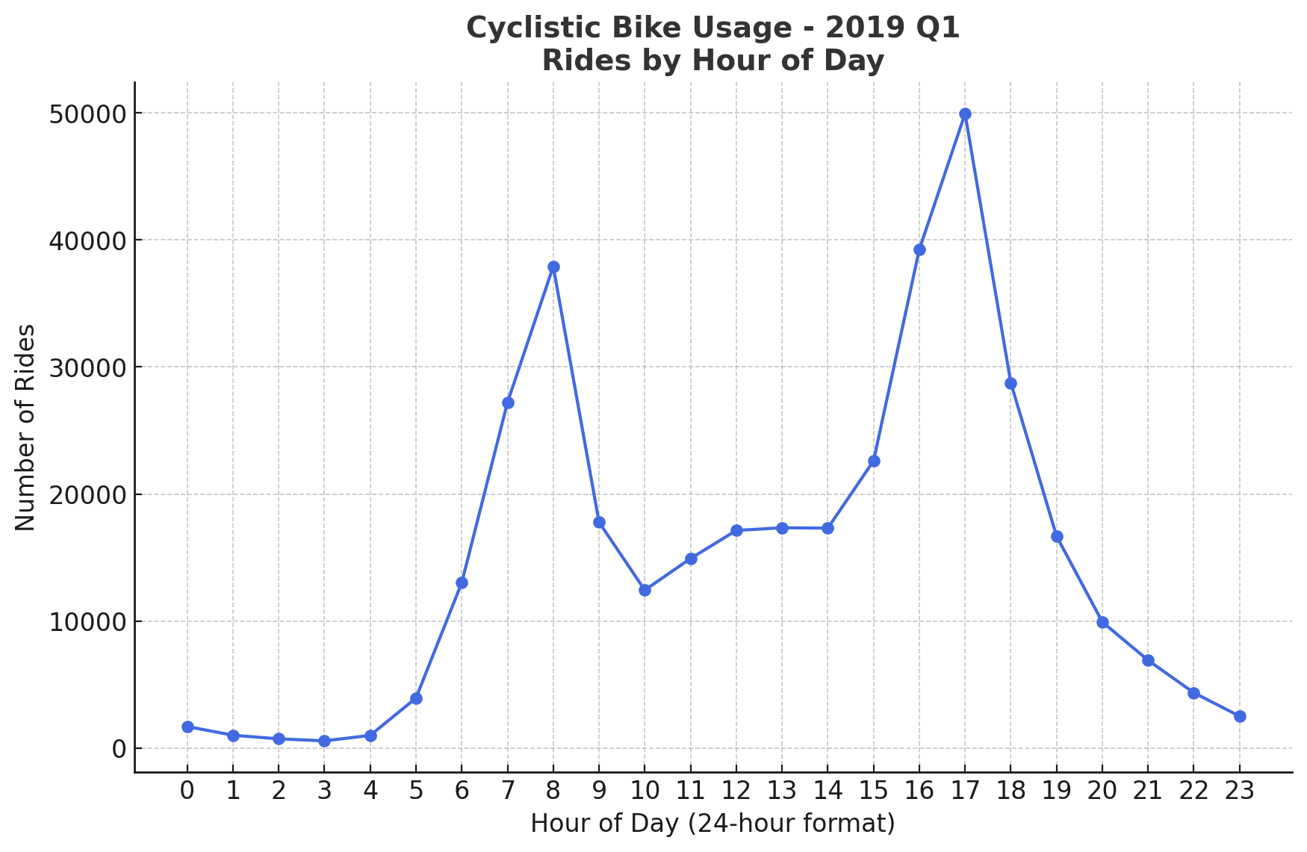

Slide 12
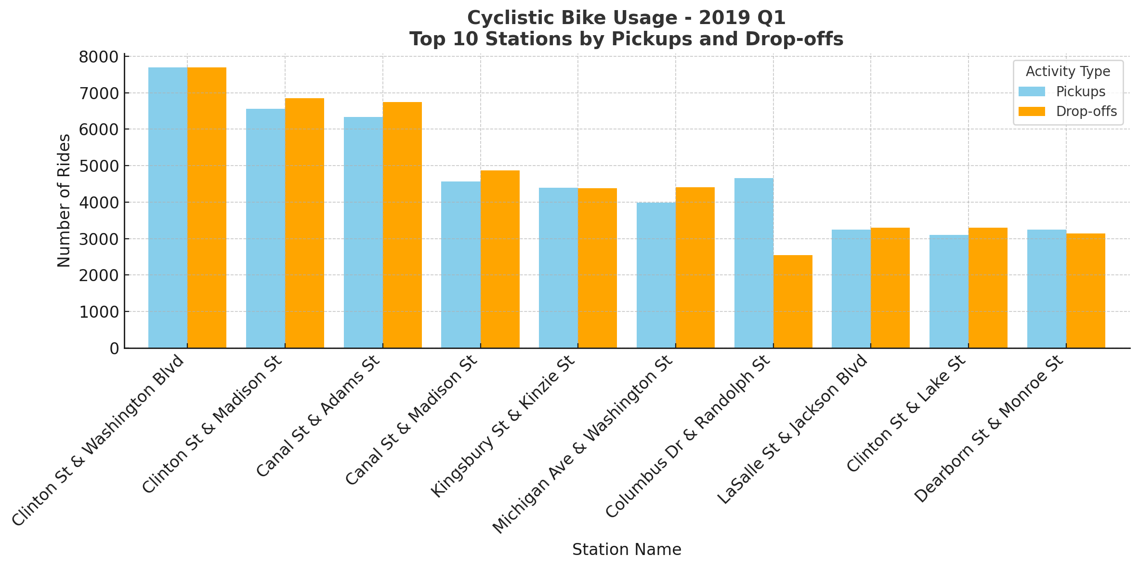

Slide 13
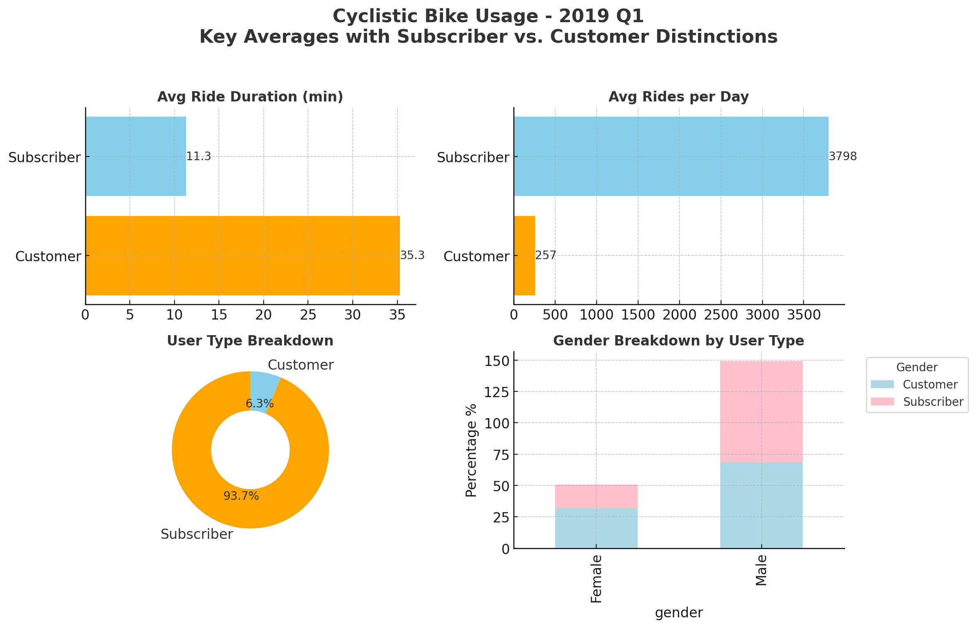

Slide 14
Key Takeaways for Increasing Subs.
Discount rides between the hours of 7PM-10PM on weekdays and general discounts on weekends.
Heavily shift marketing budget toward women.
Have better subscription options, allowing a subscription to be based off hours used (5,10,15 etc.)

